Slide 1
CSCI 4110 Rendering The Basics
Mark Green
Faculty of Science
UOIT

Slide 2
Introduction
Rendering is the process of creating an image, the algorithms and techniques that we use for image synthesis
This is a very broad topic:
Basic 2D rendering
Basic 3D rendering
Photorealistic rendering
Non-photorealistic rendering
Visualization
Small number of techniques appear in all areas, quite often concepts will transfer
Could have a course on each of these topics

Slide 3
Introduction
One common concept, quality vs. time:
For interactive applications rendering must be as fast as possible, special effects want the highest possible quality
 | Low Quality | High Quality
Fast | Real-time rendering | Impossible?? Special cases - PRT
Slow | Why bother?? | Photorealistic rendering

Slide 4
Outline
The basics:
Viewing
Projections
Hidden surface
Local illumination:
Textures
Shadows
Global illumination:
Classical ray tracing
Classical radiosity
Stochastic methods
Real-Time Rendering

Slide 5
Viewing and Projection
Covered in first graphics course, but worth a quick review
Have a 3D environment, producing a 2D image
Need to transform 3D space to 2D space
Need to know where we are looking from, camera position, called the viewing transformation
Projections take 3D geometry to 2D geometry
A wide range of projections, the most common one in rendering is the perspective projection
Projections are represented by a 4x4 matrix

Slide 6
Projections
Of interest to art and mathematics as well as computer graphics, several books on the topic
Greeks understood the basics of projections
Refined in the 900s by Arab mathematicians
Development of modern version started in Italy in the 1400s
Final version required coordinates and matrices that were developed later
Over 2000 years of history!

Slide 7
Transformations
OpenGL gives us a lot of freedom, particularly after version 3.3
Historically graphics packages forced either column or row vectors, with shaders we decide how we want to do transformations
Core OpenGL after 3.3 has no support for transformations, it’s up to us
Graphics community has largely standardized on column vectors, so we will use that

Slide 8
Transformations
Using homogeneous coordinates scale and translation are easy, as are many other transformations
Rotation is the hard one
Usually start with rotation about three coordinate axis, called Euler angles
The matrices are easy, but in general they don’t work
Gimbal lock, can rotate one axis onto another and lose a degree of freedom
Euler angles don’t produce all possible 3D rotations

Slide 9
Transformations
Need to use either rotation matrices or quaternions to do rotations correctly
Quaternions are better for interpolation, but we need a matrix to combine with other transformations
Can easily convert between matrices and quaternions, so for now we will concentrate on rotation matrices

Slide 10
Transformations
Rotation matrices have the following useful properties:
M M^{T} = I, to invert a rotation matrix take its transpose
The columns and rows are orthogonal
These properties can be used to construct rotation matrices
Example: convert first row of matrix to a column vector and rotate it, the result is (1, 0, 0, 1)
The same thing happens with the second a third rows

Slide 11
Transformations
If I have three orthogonal unit vectors, I can construct a matrix that will rotate these vectors onto the x, y and z axis by just making them the rows of the matrix
If I only have two vectors, I can construct the third vector by taking the cross product
If the vectors aren’t orthogonal, I can still construct a rotation matrix by taking the cross products of the vectors
Inverse transformation constructed by using the vectors as the columns of the matrix

Slide 12
Coordinate Systems
Traditional graphics pipeline based on three coordinate systems:
World – model transformation matrices
Eye – produced by viewing transformations
Window – produced by projections
We don’t need to use these coordinate systems in OpenGL, we can come up with our own set
But, they tend to be a good match for most applications, so we will explore them

Slide 13
Coordinate Systems
Each object in our model can have its own coordinate system, but we need a single world coordinate system when it comes to display
Called the world coordinate system
One or more matrices used to convert from object coordinates to world coordinates
May want to have the model matrix as a separate uniform in shaders since it could change more frequently than the other matrices

Slide 14
Coordinate Systems
The view matrix converts world coordinates to eye coordinates
In the eye coordinate system the viewer is looking down the z axis and the y axis points up
There are many ways of producing this matrix, they are all based on constructing a viewing frustum, see next slide
One way is to use the look at technique based on three vectors:
Eye position
Point we are looking at
Up vector

Slide 15
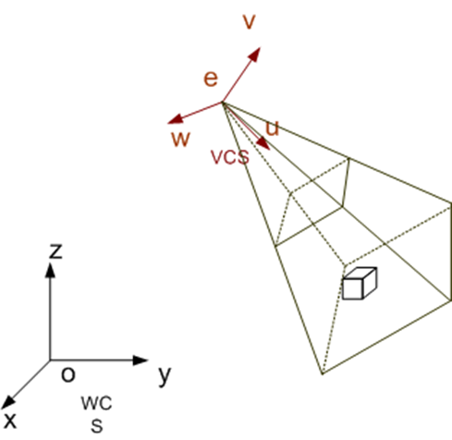
Coordinate Systems

Slide 16
Coordinate Systems
In this case the frustum is symmetric about the viewing direction, called an on axis projection
Don’t always want this, most head mounted displays and projection systems need an off axis projection
Specified in the following way:
Distance to the near and far clipping planes, the z axis in eye coordinates
The extent in the x and y axis of the near clipping plane

Slide 17
Coordinate Systems
The window coordinate system is a cube centered at the origin, the min and max points of the cube are (-1, -1, -1) and (1, 1, 1)
The projection matrix converts eye coordinates into this system
Easy to scale to the final display device, or window on the screen
Many projections could be used, they all have their own matrix:
David Salomon, Transformations and Projections in Computer Graphics, Springer, 2006

Slide 18
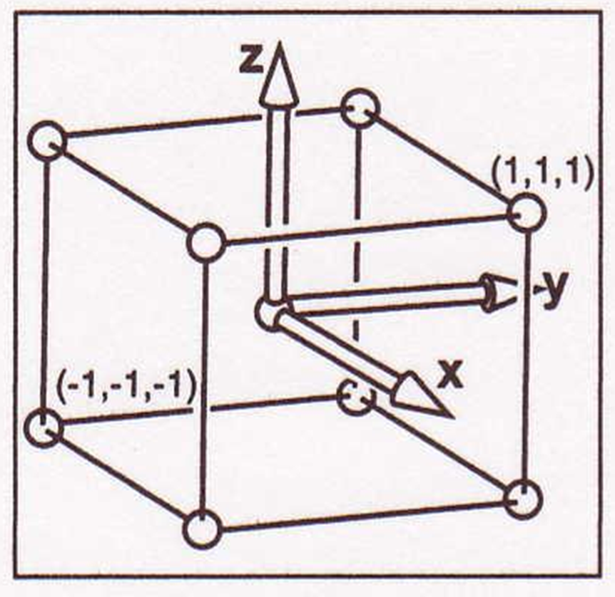
Coordinate Systems

Slide 19
Hidden Surface
Early algorithms were scan line based, solved the problem one line at a time, sorted polygons in screen space and depth
Now solved in hardware, depth buffer
Each pixel has a depth, distance from eye
When we write a new pixel we compare its depth to depth buffer:
If closer, draw the pixel and update the depth buffer
Otherwise, ignore the pixel
Essentially done for free in modern hardware, just need some extra memory

Slide 20
Hidden Surface
In producing an image we may write to a given pixel several (or many) times, but the one that remains at the end is the one closest to the viewer
This algorithm isn’t perfect, since it can waste time on polygons that aren’t visible, but its simplicity and hardware implementation often make up for the inefficiency
But, there is a problem that we need to be aware of, depth buffers have a limited resolution
If our viewing transformations aren’t set up correctly multiple pixels, separated in z may map onto the same value in the depth buffer

Slide 21
Hidden Surface
On most graphics displays the z buffer is made up of 16 or 24 bit integers
We scale the z values so they fit within this range
If we have a parallel projection the z values will vary linearly from the near clipping plane (n) to the far clipping plane (f), and we have B possible values (which will be either 2¹⁶ or 2²⁴), so we will get B bins of z values, with each bin having the size:
Δz = (f-n)/B

Slide 22
Hidden Surface
As long as all the polygons are more than Δz apart there will be no problems
If they are closer, the z buffer will think they have the same z value, so it won’t be able to determine the correct pixel
If we are lucky, it will always choose the pixels from the same polygon
In practice we are usually unlucky, and we will get a mixture of the two polygons
This does not look very good

Slide 23
Hidden Surface
To avoid this problem we need to carefully select n and f to give the smallest possible Δz
Many beginning graphics programmers set f to a large value, just because they think its safe, then wonder why their images don’t look right
The problem is more serious with the perspective projection, since the bins are no longer the same size

Slide 24
Hidden Surface
The projected z value is related to z_{w} the world z value in the following way:
z = n+f-fn/z_{w}
This comes straight from the perspective projection matrix
Which gives us the following relationship upon differentiation:
Δz ≅ fnΔz_{w}/z_{w}²
Δz_{w} ≅ z_{w}²Δz/(fn)

Slide 25
Hidden Surface
In model or world space the bins don’t have a uniform size and become larger as z_{w} becomes larger
The worst case occurs at z_{w}=f where the bin size becomes
fΔz/n
Note that this implies that we should never set n=0, otherwise the bins will become extremely large as we move away from the eye

Slide 26
Hidden Surface
With perspective projections we need to be aware that the bins become larger as we move away from the eye
It has been argued that the objects further away are less important, so this is natural
But, it will still produce an ugly image, even if the objects are far away
Floating point z buffers are used on modern high end graphics cards, which don’t suffer as much from this problem

Slide 27
Hidden Surface
Depth buffer was initially considered impractical due to the need for extra memory, now not a problem
Became practical in the 1980s
Painter’s algorithm, version still used today
Draw the objects from back to front, draw the furthest object first
Closer objects are drawn over further objects and hide them
All we need is the correct order to draw the objects!

Slide 28
Hidden Surface
Objects are usually polygons, sort in screen space after viewing and projection
Problem: polygons can overlap in z, may not be able to sort them
Also sorting a large number of polygons is slow
But, what if we can sort them in constant time, where the constant is very small (almost zero)??
What if the order was correct for any viewpoint?
This is the idea behind binary space partitioning trees, or BSP trees

Slide 29
Hidden Surface
Observation: a plane divides 3D space into two half spaces, every polygon has a plane equation
Given a point p = (x,y,z), the plane equation tells us which half space the point lies in
Plane equation:
ax +by +cz + d = 0
All points in polygon satisfy this equation, note (a,b,c) is the normal direction
Points in the positive half space have a positive value in the plane equation, points in the negative space have a negative value

Slide 30
Hidden Surface
A BSP tree is a binary tree with a polygon at each node, each polygon has a plane equation that is used to order the tree
Given the eye position, traversing the BSP tree draws the polygons in the correct order
If the eye is in the positive half space, the polygons on the negative branch are further away than the ones on the positive branch
Otherwise the polygons on the positive branch are further away than the negative branch
The algorithm is on the next slide

Slide 31
Hidden Surface
draw(tree, eye) {
if(tree.plane(eye) < 0 {
draw(tree.positve, eye)
display tree.polygon
draw(tree.negative, eye)
} else {
draw(tree.negative, eye)
display tree.polygon
draw(tree.positive, eye)
}
}

Slide 32
Hidden Surface
This algorithm works for any eye position, once the tree is built we can easily move around the model
Displaying a BSP tree is easy, but constructing one is challenging
Problem: the nodes contain polygons from the model, their planes are likely to cut other polygons on the model
Polygons will not easily fit into the negative or positive branch, will need to split polygons to make tree construction possible
The next slide is the basic algorithm

Slide 33
Hidden Surface
bulidTree(polygonList) {
while(polygonlist not empty) {
p = select(polygonList)
addPolygon(BSPTree,p)
}
}
addPolygon(BSPTRee, p) {
If(BSPTree is empty) {
n = new Node();
n.polygon = p
} else {
split(BSPTree.plane, p, negParts, posParts)
addPolygon(BSPTree, negParts)
addPolygon(BSPTree, posParts);
}
}

Slide 34
Hidden Surface
The split procedure takes a plane and a polygon and splits the polygon at the plane
If we are dealing with general convex polygons, it will produce at most one polygon for each of the negative and positive sides
The real issue is with the select() procedure that selects the next polygon to add to the tree
A bad selection will cut a lot of polygons and greatly increase the size of the tree
Want to produce the smallest tree possible, quicker to display

Slide 35
Hidden Surface
There are no efficient algorithms for constructing an optimal BSP tree, at least in 3D
At each step need to select the polygon that splits the fewest other polygons, plus the resulting split polygons split the fewest polygons ….
Several heuristics get close to optimal
Randomly select one of the polygons from the list and hope for the best
Randomly select a small number of polygons (< 5) and then select the one that splits the fewest other polygons

Slide 36
Summary
Have briefly examined several topics that are common to most rendering algorithms:
Coordinate systems
Viewing
Projections
Hidden surface problem
Also discussed the construction of rotation matrices

